Slide 1
(Informatica per le)
digital humanities
INTERCULTURAL STUDIES IN LANGUAGES AND LITERATURES
Università degli studi di Bergamo
2023-2024
Mario VErdicchio

Slide 2
mario.verdicchio@unibg.it
https://cs.unibg.it/verdicchio/dh.html
FRIDAYS 15:00 – 18:00 SALVECCHIO 5

Slide 3
Tests
Pass/Fail
Multiple choice questionnaire
10 questions (6 correct answers = pass)
JUNE 04
July 16
July 31
September 05
September 19

Slide 4
lectures
february: 23, 29*
march: 1, 8, 15, 22*
april: 5, 12, 19, 23*, 26
may: 3, 10
Feb 29: lecture on AI and society in room galeotti (via Caniana 2) at 6PM https://dllcs.unibg.it/it/eventi/convegno-intelligenza-artificiale-concetti-e-contatti
MAR 22: regular lecture + lecture on AI and work in borsa merci bergamo (details soon)
apr 23: lecture on ai and journalism at eco di bergamo (details soon)

Slide 5
(Informatica per le)
digital humanities
Lecture 1
february 23 2024

Slide 7
1
2
3

Slide 8
digital humanities ?
Questions

Slide 9
what were, are and will be the humanities in Western, and now world, culture?
What is the role of the digital within the academy, in scholarly communication and in the humanistic disciplines as a whole?
Are the digital humanities a series of practical approaches?
Are they a distinct discipline with its own set of standards, distinguished researchers, hierarchies and rules of engagement?
is the term digital humanities a redundancy?
Or has the arrival of the digital forever changed the way humanists work?
Is technology determinative?
What role does the solitary scholar have in a digital environment that is increasingly collaborative?

Slide 10
1
2
0

Slide 11
Digital Humanities is an area of research and teaching at the intersection of computing and the disciplines of the humanities. Developing from the fields of humanities computing, humanistic computing, and digital humanities praxis, digital humanities embraces a variety of topics, from curating online collections to data mining large cultural data sets. Digital humanities (often abbreviated DH) currently incorporates both digitized and born-digital materials and combines the methodologies from traditional humanities disciplines (such as history, philosophy, linguistics, literature, art, archaeology, music, and cultural studies) and social sciences with tools provided by computing (such as data visualization, information retrieval, data mining, statistics, text mining, digital mapping) and digital publishing.
Digital Humanities. (N.d.) in wikipedia. 2015 (from Gardiner E., Musto G., 2015, p.4)
1

Slide 12
Digital humanities asks what it means to be a human being in the networked information age and to participate in fluid communities of practice, asking and answering research questions that cannot be reduced to a single genre, medium, discipline, or institution. . . . It is a global, trans-historical, and transmedia approach to knowledge and meaning-making
2
Burdick A., Drucker J., Lunefeld P. Presner T., Shnapp J., 2012, p. VII

Slide 13
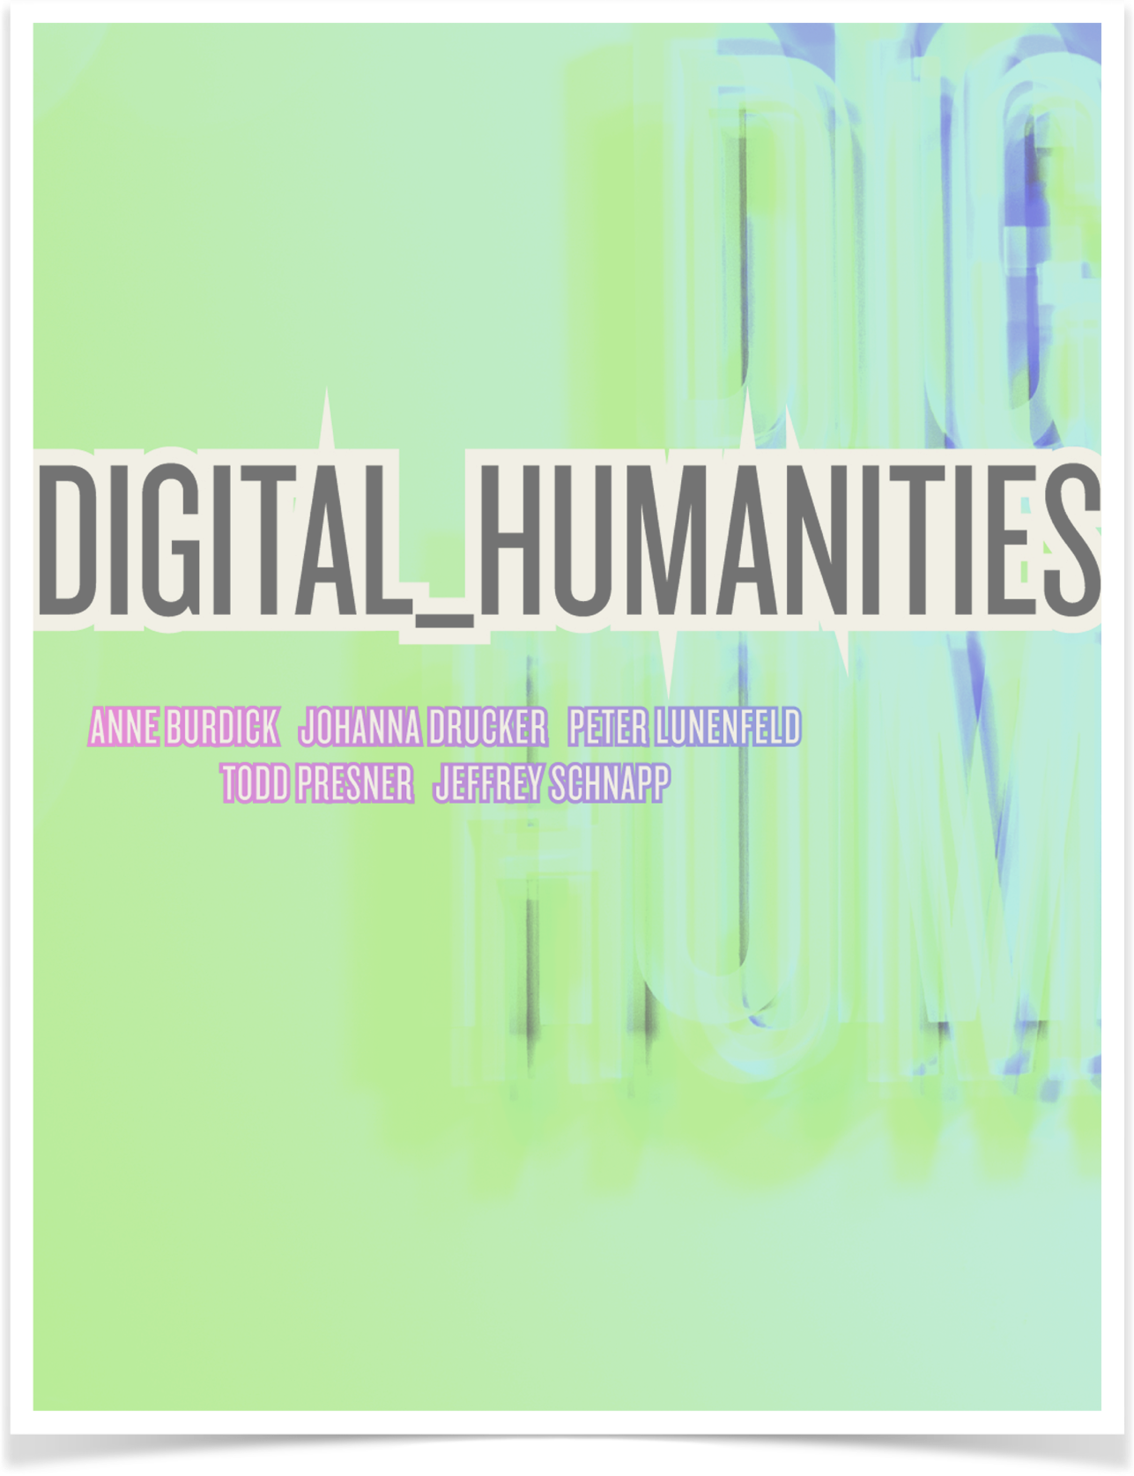
2

Slide 14
Jeffrey schnapp

Slide 15
COMPUTATIONAL METHOD
Jeffrey Schnapp
HARVARD EDEX

Slide 16
And those are two very different sets of questions, and they have strong social and ethical and historiographical implications.
They're not going to make the same assumptions.
They're not going to ask the same questions, and they're probably not going to use the same tools.
JeffreY Schnapp, COMPUTATIONAL METHOD, EDEX COURSE

Slide 17
WHAT IS DIGITAL HUMANITIES?
Various Authors
HARVARD EDEX

Slide 18
https://imperiia.omeka.fas.harvard.edu
https://dhlab.yale.edu/projects/neural-neighbors.html
https://oxfordfriars.wordpress.ncsu.edu
https://library.harvard.edu/collections/scanned-maps
http://giza.fas.harvard.edu
https://metalabharvard.github.io
LINKS TO DH PROJEXTS

Slide 19
Key words quoted
clear pleasure
information data
computational analysis
interdisciplinary
collaborative , connections , designers are at the center of the network
broader range of material
perceive changing
media history in history
metadata , network analysis etc.
all these key words are very fascinating, and could constitute a sufficient reason to delve into the discipline of DH

Slide 20
OXFORD FRIARS PROJECT FILM
Great houses make not man holy: Mendicant Architecture in Medioeval Oxford
J. Knowles, M.Koszycky
https://vimeo.com/26658584

Slide 21
digital humanities

Slide 22
we can use the methods of contemporary humanities in studying digital objects
we use digital technology in studying traditional humanities objects

Slide 24
digital
Notes:
I’ll try to define Digital in an improper way.
I’m not a mathematician, neither an IT scientist at all, so I must ask for help to prof. Verdicchio and to his work for a good definition, this will be my improper way, because of my ignorance on the specific matter. So let’s start to draft this term, for sure Prof. Verdicchio will be better than me with you on another occasion.
Starting from a technological field to a sociotechnological (sosio) one, that is from physical properties of computer components to their management in a society, we have to reflect on the success (saxess)of “Digital turn”, that is, in my opinion, the DIGITAL of Digital Humanities instead of computing humanities
Here I summarize some quotations from The digital in digital art, edited in 2018 by professor Mario Verdicchio, Studi di estetica, anno XLVI, IV serie, 3/2018, ISSN 0585-4733, ISSN digitale 1825-8646, DOI 10.7413/18258646060
——————————————————————————————————————————
p.32
By “technological” I mean characteristic of computers that depend on the physical properties of their components, which can be analysed in isolation. Instead, by “sociotechnical” I refer to those aspects of digital technology that derive by the fact that these artefacts are conceived, designed, built, and deployed in society, and thus their working is based on agreements, conventions, contracts and, more in general, all sorts of relations holding within the human society.
p.52
Every aspect of digital technology, from the most basic and physical (e.g. the electric pulses inside a circuit) to the most elaborated and abstract (e.g.the visual interface of a Web browser), are based on agreements between organizations.
I will argue against the traditional chasm between the “analog” and the “digital”by showing that not only the two technologies are not in opposition, but they coexist, and that digital technology is predominant because it allows for easier storage and transmission of data, which lead to two key aspects: memory and connectivity
p.33
Indeed, if we observe digital technology up-close, we notice that analog and digital instruments have more shared features than dif-ferences. In electronics, although analog signals are treated as a con-tinuous and dense series of voltage values and digital signals as a discrete sequence of voltage pulses, from a physical perspective they
are the same phenomenon, that is, they are all electromagnetic waves.
digital signals are much easier to store and transmitover long distances than analog signals—
This is the key difference that determined the success of digital technology over the analog. It is a matter of practicality rather than an actual ontological distinction: most systems now rely on digital signals because they are less affected by disturbances and this makes , them easier to store and to
p.36
Another success factor for digital memories derives from the versatility of the binary code, which enables computer designers to easily create encodings, that is, mathematical correspondences between finite sequences of 0s and 1s and entities in the physical world.
This was the great intuition that brought digital memories to the centre stage of computer science mid-20th century: the possibility to store not only the data to elaborate, but also the instructions by which such data were to be elaborated.
Thus, digital memories with the stored program concept allowed, for the first time in the history of technology, for the storage of data and the operations to perform on those data. This was the birth of automated iteration, that is, the possibility to program a machine to perform complex sequences of different operations,
p.38
4. Connectivity
While the first digital artists were showing their works to the public,
in a very different setting, other computer scientists were looking for
ways to exploit digital technology in the field of telecommunications.
In 1969, the first version of the Internet was born: ARPANET (Ad-
vanced Research Projects Agency Network) connected three universi-
ties and one research centre in the USA (University of California Los
Angeles, University of California Santa Barbara, University of Utah,
and Stanford Research Institute) to enable the sharing of the compu-
tational power of the machines on all these premises (Roberts 1978).
The idea was rather simple but extremely clever: since digitized data
are a sequence of electric impulses, instead of sending them from
origin to destination preserving the sequence, it is possible to spread
them over different channels, and then rebuild the sequence once all
impulses reach the destination. This wouldn’t be possible with analog
signals, because one continuous wave cannot be broken down in
parts, and the advantage is that the transmission is more robust,
since if one route is not working, the data packets can be sent over
other alternative routes. Moreover, since digital data are easy to re-
generate in case of decay, noise, and drift, the signal at destination is
identical to the signal initially sent.
After 1969, more universities, research centres, and military bases
P. 40
The technical advancements between the 1990s and the 2010s in terms of the contents that a browser can show are obvious: in little more than a decade we go from text and digital photographs to fullfledged videos, superpositions of computer-generated graphics and photos, computer-generated graphics interacting with user-generated drawings on the fly, and so on. These enhancements, which are theoretically made possible by the digitisation of the contents, are made practically feasible by the technological evolution of digital devices, comprised of circuits that are every year more miniaturised and
denser with transistors, which increases the number of operations that a computer is able to perform per unit of time.
conclusioni estetiche di Mario
If art is about ideas, and we are looking for new ideas about this
ever-changing world, we should let digital technology be an incredibly
sophisticated backdrop to the artists who are able to use it to express
themselves more effectively, and not the other way around.

Slide 25
...I will argue against the traditional chasm between the “analog” and the “digital”by showing that not only the two technologies are not in opposition, but they coexist, and that digital technology is predominant because it allows for easier storage and transmission of data, which lead to two key aspects: memory and connectivity…
....digital signals are much easier to store and transmit over long distances than analog signals This is the key difference that determined the success of digital technology over the analog. It is a matter of practicality rather than an actual ontological distinction: most systems now rely on digital signals because they are less affected by disturbances and this makes , them easier to store and to transmit over long distances than analog signals...
...Another success factor for digital memories derives from the versatility of the binary code, which enables computer designers to easily create encodings, that is, mathematical correspondences between finite sequences of 0s and 1s and entities in the physical world. This was the great intuition that brought digital memories to the centre stage of computer science mid-20th century: the possibility to store not only the data to elaborate, but also the instructions by which such data were to be elaborated...
...Thus, digital memories with the stored program concept allowed, for the first time in the history of technology, for the storage of data and the operations to perform on those data. This was the birth of automated iteration, that is, the possibility to program a machine to perform complex sequences of different operations...
The technical advancements between the 1990s and the 2010s in terms of the contents that a browser can show are obvious: in little more than a decade we go from text and digital photographs to fullfledged videos, superpositions of computer-generated graphics and photos, computer-generated graphics interacting with user-generated drawings on the fly, and so on. These enhancements, which are theoretically made possible by the digitisation of the contents, are made practically feasible by the technological evolution of digital devices, comprised of circuits that are every year more miniaturised and denser with transistors, which increases the number of operations that a computer is able to perform per unit of time...
Verdicchio M., 2018, p.52, p.33, p.36, p.40

Slide 26
To what extent do we acquire knowledge through images? How does the memory establish itself from images, manipulate them, “archive” them and recycle them?
What are the differences between the ways we perceive, feel about and remember (1) a landscape, (2) a painting of that landscape, (3) a photo of the landscape, and (4) a photo of the painting?
Can they be measured or described in neurophysiological terms as well as in terms of cultural history?
Do the two approaches – the neurophysiological and the historical – lead to comparable and perhaps convergent results, or is there no one-to-one correspondence between them?

Slide 27
humanities

Slide 28
Exceptions vs rules
Re - presentation

Slide 29
sono invece scienze morbide nelle quali il percorso è più importante del punto di arrivo, cioè fuor di metafora, nelle quali il contributo più interessante non è quello che scopre cose nuove, bensì quello che anche senza aggiungere niente all’inventario del noto, apre nuove prospettive sulle cose, ci fa pensare ai problemi a cui non avevamo mai pensato o dimostra inadeguato un risultato che si pensava acquisito senza necessariamente sostituirlo con uno nuovo
Giunta, 2017, p.298

Slide 30
humanities
to
digital humanities

Slide 31
bibliography
Burdick A., Drucker J., Lunefeld P. Presner T., Shnapp J., Digital_Humanities, MIT Press, Cambridge (MA), 2012
Gardiner E., Musto, G., The Digital Humanities: A Primer for Students and Scholars, Cambridge Univeristy Press, Cambridge (UK), 2015 (https://amzn.eu/7k8qe73)
Giunta C., E se non fosse una buona battaglia. Sul futuro dell’educazione umanistica, Il Mulino, Bologna, 2017
Harvard edex course: Introduction to Digital Methods for the Humanities, free Online Courses by Harvard, M.I.T. https://www.edx.org
Scott H., The fuzzy and the techie:why liberal arts will rule the digital world, Haughton Mifflin Harcourt, 2017
Verdicchio M., The digital in digital art, Studi di estetica, anno XLVI, IV serie, 3/2018,

Slide 32
webgraphy
Harvard edex course:Introduction to Digital Methods for the Humanities, free Online Courses by Harvard, M.I.T. https://www.edx.org
https://metalabharvard.github.io
https://imperiia.omeka.fas.harvard.edu
https://dhlab.yale.edu/projects/neural-neighbors.html
https://oxfordfriars.wordpress.ncsu.edu
https://library.harvard.edu/collections/scanned-maps
http://giza.fas.harvard.edu
https://www.ibm.com/ibm/history/ibm100/it/it/stories/linguistica_computazionale.html
http://apps.harvardartmuseums.org/lightbox/index.html

