Slide 1
ASMETA Tool Set For Rigorous System Design
Andrea Bombarda¹, Silvia Bonfanti¹, Angelo Gargantini¹, Elvinia Riccobene², Patrizia Scandurra¹
¹
²
This work was supported in part, as dissemination, by project SERICS (PE00000014) under the NRRP MUR program funded by the EU - NGEU
Notes:
This work was supported in part by project SERICS (PE00000014) under the NRRP MUR program funded by the EU - NGEU. Views and opinions expressed are however those of the authors only and do not necessarily reflect those of the European Union or the Italian MUR. Neither the European Union nor the Italian MUR can be held responsible for them.

Slide 2
Introduzione di chi siamo
Chi siamo
1 slide per persona
Tempo: 5 minuti

Slide 3
ABOUT US
Notes:
introduzione al gruppo nostro 10 minuti

Slide 4
Dott. Andrea Bombarda
2018
MSc in Computer Engineering
2022
Ph.D. Student in Engineering and Applied Sciences
Since late 2023
Research Associate
Quality of medical software
andrea.bombarda@unibg.it
Model-Based Testing and FM
Medical Software certification
Robustness evaluation of ANN
Combinatorial testing

Slide 5
Ing. Silvia Bonfanti, PhD
2013
MSc in Computer Engineering at University of Bergamo
2017
PhD in Engineering and Applied Sciences at University of Bergamo
Since 2023
Research Associate
Medical Software certification
silvia.bonfanti@unibg.it
Formal methods
3D applications for amblyopia
Quality of medical software
AAC Augmentative and Alternative Communication
Robustness evaluation of ANN

Slide 6
Prof. Angelo Gargantini
Master in Electronic Engineering 1994 and PhD 2000 at Politecnico di Milano
After jobs in industry, research centers, PA, assistant and associate professor
2021
Full Professor, DIGIP, University of Bergamo
Coordinator of the CS engineering program at the University of Bergamo
Head of the FOSELAB at UniBG https://foselab.unibg.it/
angelo.gargantini@unibg.it
Formal methods
Software Engineering
Model-driven Engineering
Software testing
Programming languages

Slide 7
Prof. Patrizia Scandurra
MSc in Computer Science (2002) and PhD in Computer Science (2006) at the University of Catania
Research fellow at the University of Milan (2006- 2008)
Assistant Professor at the University of Bergamo (2009-2017)
2017: Associate Professor at the DIGIP Dept., University of Bergamo
Department Delegate for Quality Policies,
National Scientific qualified as full professor for 01/B1 - Informatics (from 2022)
patrizia.scandurra@unibg.it
Software Engineering
Formal methods
Software Architecture
Self-adaptive systems
Model-driven Engineering

Slide 8
Prof. Elvinia Riccobene
Full Professor, CS Dept., University of Milan
http://homes.di.unimi.it/riccobene/
Head of the FALSE Lab - Formal methods and Algorithms for Large-Scale systEms @UNIMI
http://false.di.unimi.it/
Associate Professor, University of Catania & Milan
Laurea & PhD in Mathematics, University of Catania
elvinia.riccobene@unimi.it
Formal methods
Software Engineering
Model-driven Engineering
Self-adaptive systems
Healthcare
IoT security
Cyber-ranges

Slide 9
Outline
Part 1
Part 2
How to install ASMETA
Introduction to the Abstract State Machines
Overview of the ASMETA Toolset
The Pill-Box case study
The textual modeling notation
Simulation and animation
Model validation by scenarios construction
Static analysis of models
Property verification
Model refinement
Code generation
Notes:
Elvinia

Slide 10
Come installare ASMETA
Andrea
Sezione 3.1
Tempo: 15 minuti

Slide 11
Getting ASMETA

Slide 12
Getting ASMETA - Complete package
A complete package containing Eclipse with all ASMETA tools already installed and set is available at
https://zenodo.org/records/12770854
Windows (64 bit)
Linux (x86_64)
MacOs (aarch64)

Slide 13
Getting ASMETA - Update site
Manual installation can be performed by using the update site
https://raw.githubusercontent.com/asmeta/asmeta_update_site/master
In addition, if model checking functionalities are needed, the NuSMV model checker has to be downloaded and set in Eclipse
https://nusmv.fbk.eu/downloads.html

Slide 14
Getting ASMETA - Update site
Installing ASMETA from the Update Site
DEMO

Slide 15
Introduction to the Abstract State Machines
Theoretical background

Slide 16
Introduzione ad ASM + ASMETA
Elvinia
Sezione 2 + 3
No 3.1
Tempo: 30 minuti

Slide 17
Abstract State Machines
ASMs are a system engineering method able to guide the development of software systems seamlessly from requirements capture to their implementation
ASMs used in different application domains:
definition of industrial standards for programming and modeling languages
design and re-engineering of industrial control systems and safety-critical systems
e-commerce, web services, Cloud-systems, autonomous computing
verification of compilers, security protocols, etc.

Slide 18
Main references: ASM books
E.Boerger and A. Raschke, 2018
E.Boerger and R. Staerk, 2003
Report also on industrial/academic projects where ASMs have been applied
P.Arcaini, A.Bombarda, S.Bonfanti, A.Gargantini, E.Riccobene, P.Scandurra: The ASMETA Approach to Safety Assurance of Software Systems. LNCS (2021).
https://doi.org/10.1007/978-3-030-76020-5_13

Slide 19
Why the ASMs
Practitioners are reluctant to model SW REQS by using FMs due to:
lack of training
complex formal notations
lack of easy-to-use tools supporting a developer during the life cycle activities of system development
lack of a precise development process from REQs to code

Slide 20
Why the ASMs
ASMs is a rigorous formal method, but a practitioner
Needs no special training to use it
Models can be understood as pseudo-code (or virtual machines working) over abstract data structures
Has tools
For model editing, simulation, testing, static and dynamic verification, conformance checking, etc.
Has a development process
Based on model refinement
Support straightforward model to code transformation

Slide 21
ASM-based Modeling Approach
ASM formal method builds upon three main concepts:
Abstract State Machines, state-based transition systems that extend Finite State Machines
unstructured control states are replaced by states with arbitrary complex data
ground model, an ASM which is a reference model for the design w.r.t. a set of requirements
model reﬁnement, a general scheme for stepwise instantiations of model abstractions to concrete system elements

Slide 22
Abstract State Machines (ASMs)
ASMs are state-based transition systems:
S₀
S₁
S₂
…..
State: instantaneous conﬁguration of the system and its external events
State transition: application of transition rules to get state update (next state)

Slide 23
ASM state
state: multi-sorted first-order structure (algebra), i.e. domains of objects with functions defined on them
(f,(v₁,…,v_{n})) are locations
represent object container (or memory unit)
at each state, each location has a value
Location updates represent the basic units of state change and they are given as assignments:
f(v₁,…,v_{n}):= v_{next}

Slide 24
Function classification
Dynamic functions updated by transition rules
monitored: read by the machine and written by the env
controlled: read and written by the machine
out: written by the machine and read by the env
shared: read and written by the machine and the env
Static functions not updated by transition rules
Functions defined in terms of other functions are called derived

Slide 25
ASM transitions
Transition rules specify how dynamic functions change from one state to the next
Basic transition rule (guarded update):
if Condition then Updates
where Updates is a set of function updates
f(t1, …,tn):= t
simultaneously executed when Condition is true

Slide 26
ASM transition rules
More complex rule constructors exist:
guarded updates (if-then-else, switch-case)
simultaneous parallel updates (par)
non-determinism (choose)
unrestricted synch. parallelism (forall)
abbreviation on terms of rules (let)
sequential actions (seq)
domain extension (extend)

Slide 27
Execute an ASM
A run of an ASM is a finite or infinite sequence of states S₀, S₁, …, S_{n}:
starting from the initial state S₀, in a computation
step (run step) from S_{n} to S_{n+1}, all enabled transition rules are executed in parallel, leading to simultaneous updates of a number of locations

Slide 28
Erroneous execution
In case of:
an inconsistent update (i.e., a same location is updated to two different values)
or invariant violations (i.e., properties that must be true in every state are violated),
the model execution stops with error

Slide 29
Single-agent and multi-agents modeling
ASMs support both computational paradigms:
Single agent: executing the whole transition system
Multi-agents: working in parallel, each executing its own transition system in synchronous or asynchronous way
(not presented in the tutorial)

Slide 30
ASMETA Toolset
Tool components and modeling process

Slide 31
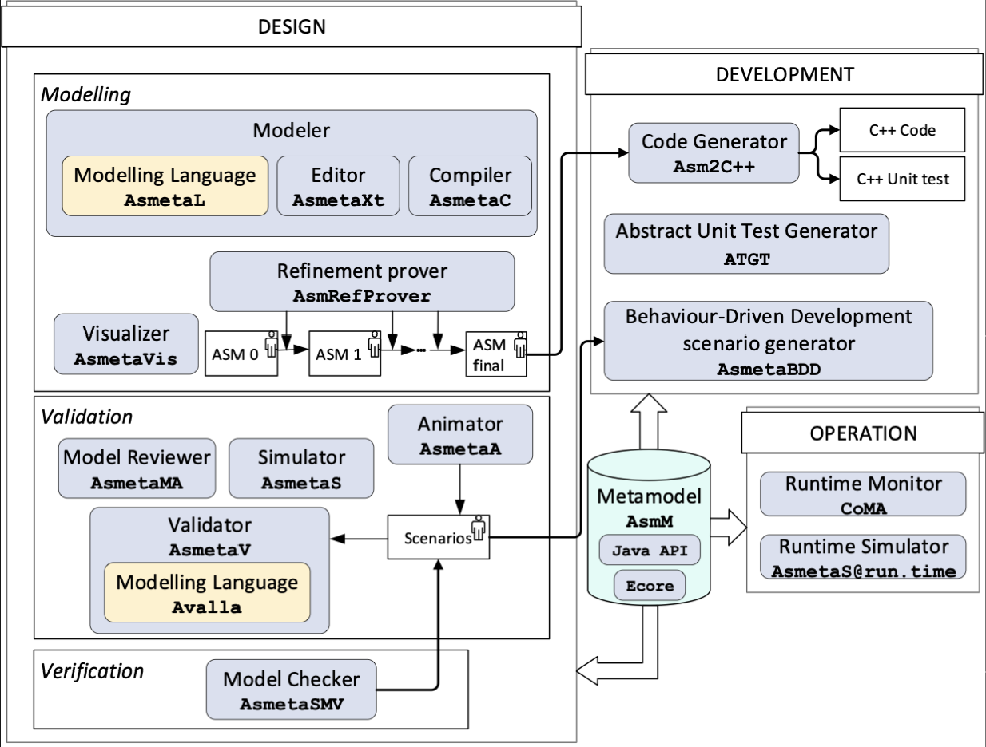
ASMETA Toolset
Developed by exploiting the MDE approach for software development
Core component: the meta-model AsmM as abstract notation to define an ASM

Slide 32
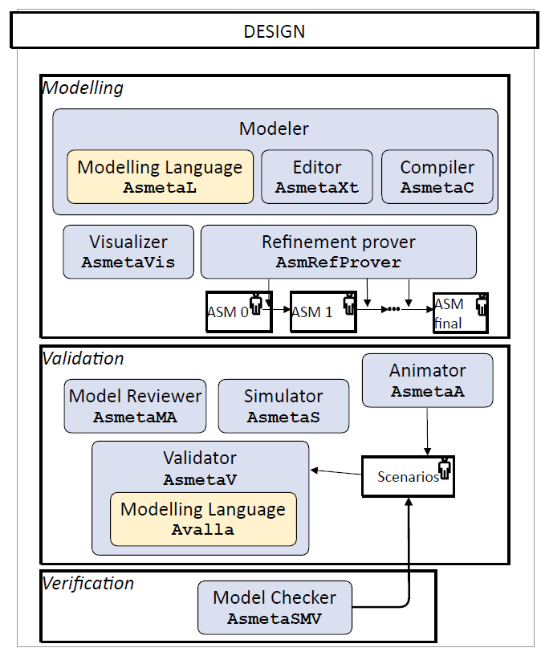
ASMETA @ design-time
Modeling
Modeling Language
Refinement
Visualization
Validation and Verification
Model Simulation
Model Animation
Scenario-based validation
Model reviewing
Model checking of temporal properties

Slide 33
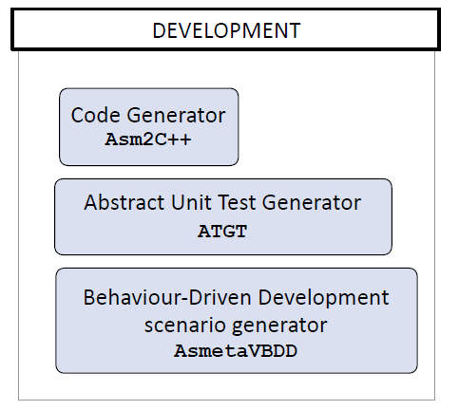
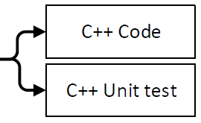
ASMETA @ development time
Automatic model-based code generation
Automatic model-based test generation
Unit test generation
Behaviour-Driven Development scenarios
acceptance test generator for complex scenarios

Slide 34
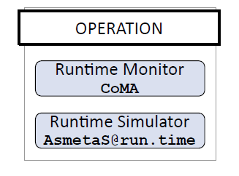
ASMETA @ operation time
Model as a twin of the real system
Runtime monitoring
Twin execution used to check correctness of the real system behavior w.r.t. model behavior
Runtime simulation
Twin execution used to prevent misbehavior of the real system in case of unsafe model behavior

Slide 35
ASMETA modeling process
Iterative process based on model refinement (akin to ASMs)
ASM₀: first high-level model (ASM ground model)
Correct: it should represent the intended requirements (at the desired abstraction level)
Consistent: no ambiguities of initial requirements should be left
Not necessarily complete: some requirements can be left out and captured later during the refinement process
Notes:
Signature and rule naming should reflect terms of application domain and textual requirements, to simplifying the process of connecting requirements to the model

Slide 36
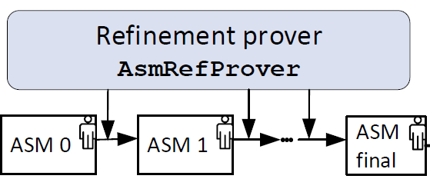
ASMETA modeling process
From ASM₀, through a sequence of refined models ASM₁, ASM₂,. . . , other functional requirements are modeled, till the desired level of completeness
ASM_{final} captures all intended requirements at the desired level of abstraction
We support proof of (a form
of) correct model refinement
step

Slide 37
Caso di studio - Pill-Box
Silvia
Spiegando i diversi raffinamenti
Sezione 4
Tempo: 10 minuti

Slide 38
Pill-Box case study
Notes:
Now I’m going to introduce the Pill-Box case study with its informal requirements,
which will be used throughout the tutorial as a running example to
describe the modeling and analysis activities supported by the ASMETA tools.

Slide 39
Pill-Box case study
Drawer 1
Drawer 2
Drawer 3
Slot 1
Slot 2
Slot 1
Slot 2
Slot 1
Slot 2
Slot 3
Slot 4
Slot 3
Notes:
A pillbox is divided into a number of drawers, in our case we assume that the pillbox has 3 drawers.
Moreover each drawer can be divided into multiple slots and each slot can contain only one pill.
Note that only one specific type of medicine can be placed in the drawer.
So, each drawer can contain multiple pills (one per slot) but all pills must be of the same drug type.

Slide 40
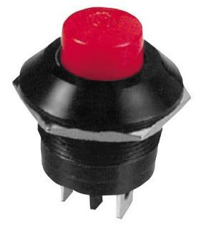
Pill-Box case study
Drawer 1
Not time to take the pill
Slot 1
Slot 2
Time to take the pill (10 minutes ON)
Slot 3
Slot 4
Notes:
Now let’s focus on one drawer. Each Pill-Box drawer has two components: a switch and a LED.
The switch is used to notify whether the pill in the drawer has been taken,
and the LED is used to communicate relevant information to the user.
When the LED is OFF, it is not time to take
the corresponding pill, while when the LED is ON, it means that the patient
should assume that pill. When it is time to take a pill, the LED stays ON for
10 minutes after the scheduled time of the pill.
If the pill is taken in the meantime the lead is turnd OFF,
Otherwise if the pill is not taken after 10 minutes the LED is turned OFF.
Note that: For each pill type, it is possible to set several deadlines throughout the day,
meaning that the same drawer might be opened multiple times. However, if two
or more pills have to be taken at the same time, the Pill-Box turns on only a
single LED per time, by randomly choosing the order in which to assume them.

Slide 41
Pill-Box case study
First model Pillbox ground
A drawer contains only a single pill (no slots) Time not modeled: information on the time passed is given by an external event
Drawer 1
Drawer 2
Drawer 3
Slot 1
Slot 1
Slot 1
Notes:
As pereviously said, a good practice when modelling complex systems,
is to start from a simple version of it and then add more details till the model with all requirements is obtained.
Here we have introduced three models for the ASMETA specification of the Pill-Box,
where each one introduces new elements for refining time and pill management:
The first model is the one we have called Pillbox ground in which
we consider only a single pill per drawer.
Moreover, time is not explicitly modeled, and information on the time passed
is given by an external event.
Later in the tutorial we will show you the differences between the ground model you will see in depth
and the other refined models implemented by adding more details.
=============================
– Model with time (pillbox time): this specification models time passing by a
timer. We still keep the abstraction of having a single pill per drawer.
– Final model (pillbox final): it captures all requirements of the Pill-Box sys-
tem, and it thus specifies multiple pills (and multiple deadlines) per drawer.

Slide 42
Pill-Box case study
First model Pillbox ground | Second model Pillbox time | Third model Pillbox final
A drawer contains only a single pill (no slots) Time not modeled: information on the time passed is given by an external event | A drawer contains only a single pill (no slots) Time is modeled using a timer | A drawer contains multiple slots
Notes:
A good practice when modelling complex systems, is to start from a simple version of it and then add more details till the model with all requirements is obtained.
Here we have introduced three models for the ASMETA specification of the Pill-Box,
where each one introduces new elements for refining time and pill management:
– Ground model (pillbox ground): here we abstract the requirement that a
drawer contains multiple slots and consider only a single pill per drawer.
Moreover, time is not explicitly modeled, and information on the time passed
is given by an external event (a monitored Boolean-valued function).
– Model with time (pillbox time): this specification models time passing by a
timer. We still keep the abstraction of having a single pill per drawer.
– Final model (pillbox final): it captures all requirements of the Pill-Box sys-
tem, and it thus specifies multiple pills (and multiple deadlines) per drawer.

Slide 43
The textual modeling notation AsmetaL

Slide 44
AsmetaL: the textual language of ASMETA
Patrizia
Presentazione notazione sul primo modello
Utilizzo dell’editor con parser facendo vedere syntax highlighting
Deve essere fatto in modo che le persone che stanno seguendo scrivono il modello in alcune sue parti
Sezione 5
Tempo: 40 minuti
Notes:
AsmetaL is the user-facing language to define ASMETA models. Let me introduce AsmetaL by using the ground model (pillbox ground). Let’s define such a model from scratch and introduce little by little all main elements that characterize an ASM model.

Slide 45
ASMETA model structure
ASM = (header, body, main rule, initialization)
header: import of modules, signature declaration
body: defs. of domains/functions, state invariants, and rules
main rule: def. of the starting rule of the machine
initialization: specifies an initial state (an initial value for domains and functions of the signature)

Slide 46
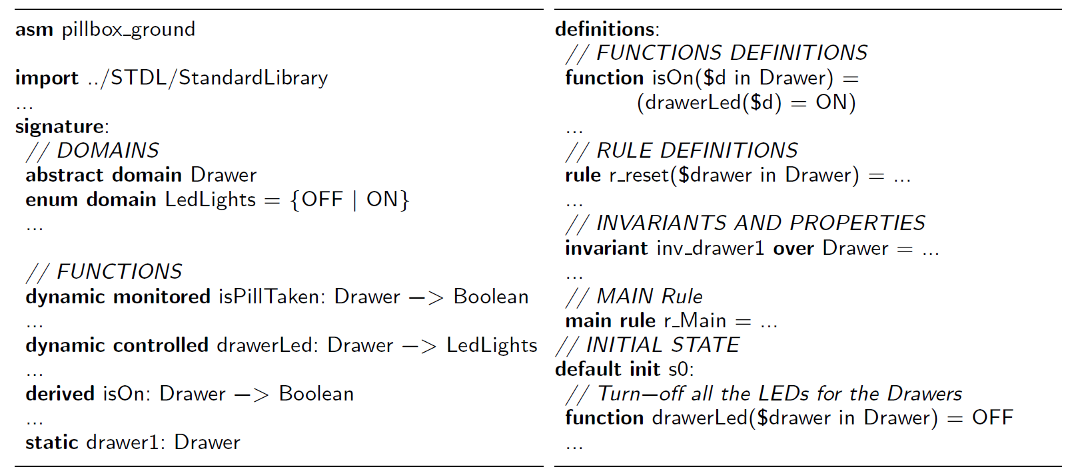
ASMETA model structure in AsmetaL
body
header
main rule
initialization
Notes:
An ASMETA specification is described in a text file with extension .asm and structured as shown in this listing. It has five main sections… Let’s see it directly within the ASMETA Eclipse Editor.

Slide 47
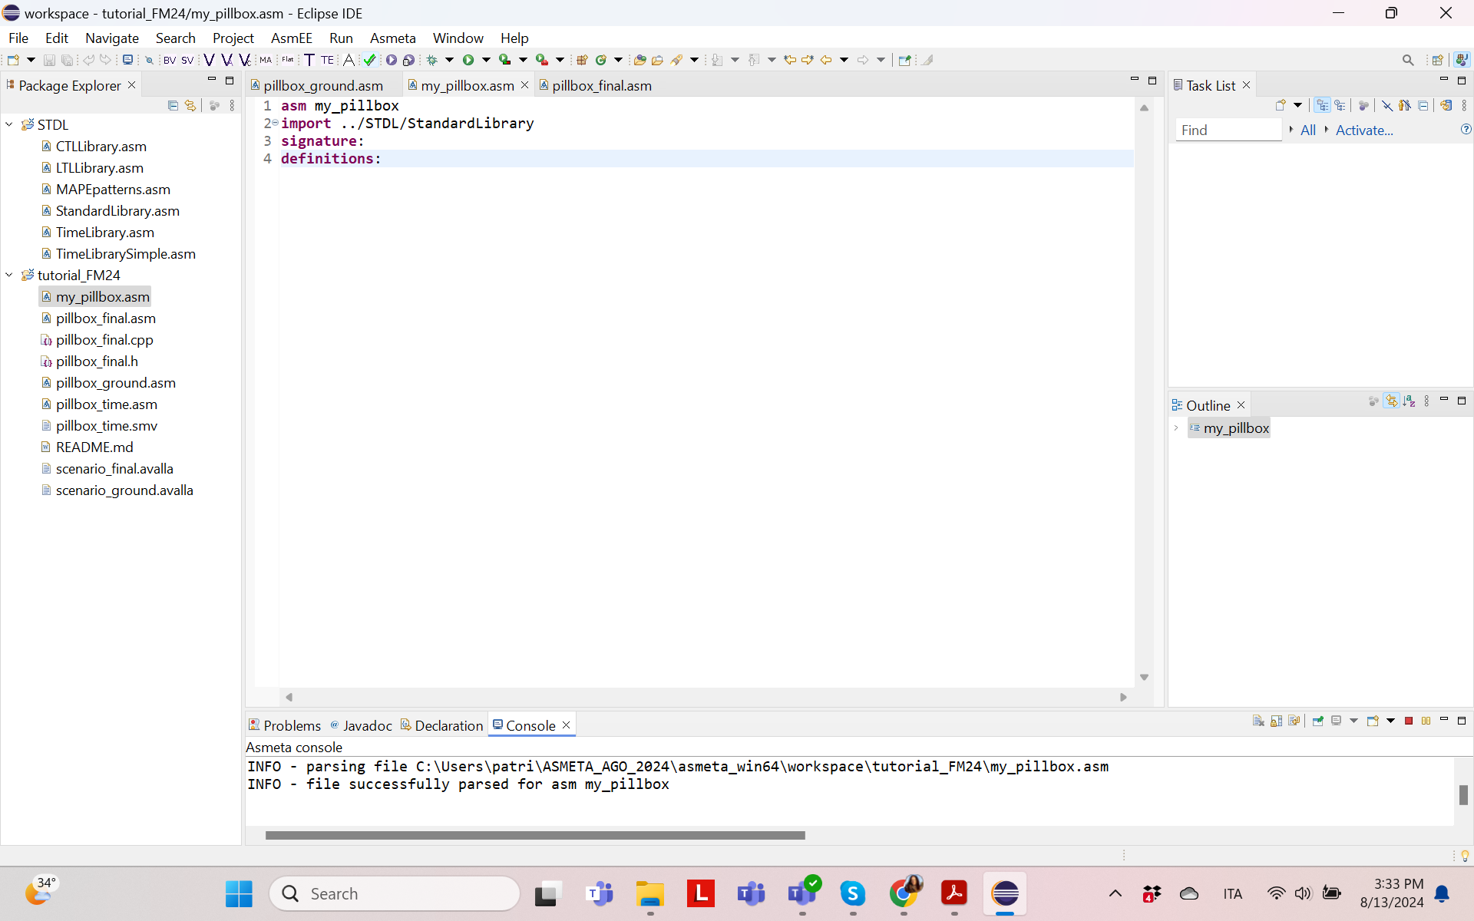
ASMETA Eclipse Editor

Slide 48
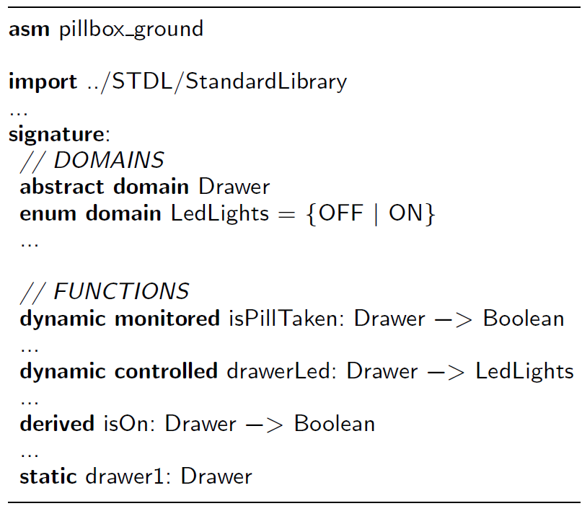
Detailed look of an ASMETA model
Model name
Keyword asm followed by the name (same as the file!)
Keyword module to define a module:
an ASM with no main rule
typically imported by other models for modularization
Notes:
We now provide a more detailed look at each part of an ASMETA model. Let’s start from the very beginning, namely from the model name. The first line of the specification contains the specification, which must be the same as the file. In our case the specification name is pillbox_ground and it must be defined in the file pillbox ground.asm.
A model without the main rule is called a module. It consists of declarations and definitions of domains, functions, invariants, macro call rules, and it can be imported by other ASMETA models. Note that an ASMETA model (the model that starts with the keyword asm) can be imported as well, except for the initial state and the main rule.

Slide 49
Detailed look of an ASMETA model
Import
Keyword import followed by the file name with its relative/absolute path
It’s mandatory to import the StandardLibrary with predefined decls. for:
primitive domains: Boolean, Natural, Integer, Complex, Char, and String
functions for main operations over base domains and structured domains (tuples, sequences, sets, and maps)
Notes:
A model can import modules by using the file name with its relative or absolute path.
The StandardLibrary is a user-ready module that defines names for basic domains and functions. This library is mandatory to import since it includes predefined names for primitive domains (like Boolean, Natural, Integer, etc.) and functions for the main operations over these domains and structured domains (for tuples, sequences, sets, bags, and maps). Other libraries are available as we’ll see.

Slide 50
Detailed look of an ASMETA model
Signature – Domains A user-defined domain can be
Finite enumeration (e.g. LedLights)
Abstract domain of (non-enumerable) abstract objects (e.g. Drawer)
Concrete domain: a named sub-domain of another domain; e.g.: domain Coord subsetof Integer
Notes:
In addtion to basic domains from the standard Library, a modeler can introduce other domains.
User-defined domains take a name and can be:
Enum domains: finite enumeration of elements defined by the user.
Abstract domains: (non-enumerable) user-defined domain to describe abstract entities of the real word.
Concrete domains: user-named domain defined as sub-domain of another domain.
Drawer is an abstract domain representing the drawer objects; such objects
typically do not have a precise structure and the user further characterizes them
by introducing functions over them (see next paragraph). LedLights is the enumeration
for the light status of the LEDs; Drugs is the enumeration of three
different types of drugs (Tylenol, Aspirine, and Moment).

Slide 51
Detailed look of an ASMETA model
Signature – Domains Other domains (not to declare) are structured domains like sequences, tuples, sets, and maps:
monitored f1: Seq(Integer) -> Boolean //e.g. f1([3,5]) = true
monitored f2: Prod(Integer, Boolean) //e.g. f2=(1,true)
monitored f3: Powerset(Integer) //e.g. f3 = {1,2,3}
monitored f4: Map(LedLights,Boolean) //e.g. f4 = {OFF -> false, ON -> true}
Notes:
Structured domains: representing structured data (like finite sequences, tuples, sets, and maps) over other domains; examples are the Cartesian Product of two or more domains, and the mathematical Powerset of a domain.

Slide 52
Detailed look of an ASMETA model
Signature – Functions decls.
Keyword dynamic is optional
Use keywords:
static for static functions (e.g. constant drawer1)
monitored, controlled, shared, and out for dynamic functions
derived to introduce functions computed in terms of other functions (e.g. isOn)
Notes:
Basic functions form the basic signature of the machine and are classified into static, which never change during any run of the machine, and dynamic, that may be changed by the environment or by the machine updates.
Dynamic functions are further divided into monitored, controlled, shared, and out.
AsmetaL adopts appropriate keywords for declaring all these kinds of functions.
Examples of declarations of static functions are the constants representing the three drawers (elements of the abstract domain Drawer).
Examples of declarations of dynamic functions are as follows:…
Examples of declarations of derived functions are as follows:…

Slide 53
Detailed look of an ASMETA model
Definitions – concrete domains and functions defs.
keyword domain to define a concrete domain, e.g.: domain Coord = {1 : 3}
keyword function to define static and derived functions (e.g. the derived function isOn)
use prefix $ for freely occurring variables
Notes:
Once declared, concrete domains, static and derived functions must also be defined explicitly in the definitions section.
The notation to define a concrete domain is as in the example: Coord
For defining, for example, the derived function isOn we exploit the drawerLed controlled function to compute it. IsOn is used as guard in the transition rules.
Note that in AsmetaL the name of a variable freely occurring in a rule starts with the prefix $.
Note that: Per me anche quelle statiche vanno definite. Forse dovremmo dire che nella definizione di statiche non possono comparire quelle dinamiche
somma($x in integet, $y in integer) = $x + $y

Slide 54
Detailed look of an ASMETA model
Definitions - Rules
Use the keywords macro (it is optional) and rule, followed by the name of the rule with the prefix r_, the list of variables with their typing domains, and the rule body
e.g. the par-rule r_reset to reset a drawer
rule r_reset($drawer in Drawer) = par
drawerLed($drawer) := OFF
isPillTobeTaken($drawer):= false
endpar
Notes:
In AsmetaL, the transition rules can be defined after the definition of concrete domains (if any) and functions.
A rule definition starts with the keywords macro (it is optional) and rule, followed by the name of the rule with the fixed prefix r_, the list of free variables and their typing domains, and the rule body (containing occurrences of the free variables).
As an example of rule definition, consider the rule r_reset that uses a par rule to reset the status of a given drawer (in parallel it sets the led to OFF and isPillTobeTaken to false): …

Slide 55
Detailed look of an ASMETA model
Definitions - Rules
Another example: a choose rule for the non-deterministic choice of one pill to take when there are more to take at a time
rule r_choosePillToTake = choose $drawer in Drawer with
isPillTobeTaken($drawer) and isOff($drawer)
and not areOthersOn($drawer) do
drawerLed($drawer) := ON
Notes:
// Non-determinism: Only a single RedLight is to be on at a time, so choose randomly the order of the pills

Slide 56
Detailed look of an ASMETA model
Definitions - Invariants and properties
keyword invariant followed by the name, keyword over with the list of constrained domains or functions or rules, and the boolean expression; e.g.:
Temporal logic properties can be defined as well (see later in the tutorial)
invariant inv_drawer1 over Drawer: (forall $d in Drawer with (isOn($d) implies not areOthersOn($d)))
Notes:
Invariants allow users to specify first-order logic formulas that must be true in each computational state during model execution.
In AsmetaL, invariants are defined after rule definitions but precede the main rule definition
Computation Tree Logic (CTL) and Linear Temporal Logic (LTL) properties can be defined as well, but this is later explained with the model verification technique

Slide 57
Detailed look of an ASMETA model
Definitions - Main rule
Keyword main rule
Rule def. with no formal parameters
As in structured programming, it may invoke other rules
E.g. (note syntax [] for rule invocation)
main rule r_Main = par
// Non-determistic choice of the pill
r_choosePillToTake[]
// Handle other states
r_setOtherDrawers[]
endpar
Notes:
Its definition follows those of invariants and properties, and has no formal parameters (its arity is 0)
The main rule of the Pillbox ground is in charge of simultaneously (i) choosing one drawer with a pill to take (if any) and (ii) managing the state of the other drawers.
Once defined, a named rule can be invoked (like in structured programming) within the rule body of another rule by using the rule name followed by the list of actual arguments (if any) surrounded within square brackets (e.g., r reset[$drawer]). When the rule is invoked, it is expanded by replacing every variable freely occurring within the rule body with the actual argument of the invocation (the association is positional).

Slide 58
Detailed look of an ASMETA model
Initial state
default initialization of controlled functions to the value they must assume when the model execution starts
keywords default init followed by a state name, :, and same notation for static/derived function defs.
e.g. s0
Notes:
At the end, in the initialization section, we can insert a default initialization of controlled functions
An ASMETA model may contain the initialization of controlled functions to the value that they must assume when the execution of the model starts.
The syntax and grammar rules to assign an initial value to a controlled function is the same for defining static/derived functions.
: read “colon”
We can define more than one init state, but the one used for execution is that with the keyword default.

Slide 59
Break

Slide 60
ASMETA Tool Set For Rigorous System Design
2° PART
Andrea Bombarda, Silvia Bonfanti, Angelo Gargantini, Patrizia Scandurra - University of Bergamo
Elvinia Riccobene - University of Milan
This work was supported in part, as dissemination, by project SERICS (PE00000014) under the NRRP MUR program funded by the EU - NGEU
Notes:
This work was supported in part by project SERICS (PE00000014) under the NRRP MUR program funded by the EU - NGEU. Views and opinions expressed are however those of the authors only and do not necessarily reflect those of the European Union or the Italian MUR. Neither the European Union nor the Italian MUR can be held responsible for them.

Slide 61
Outline
Part 1
Part 2
Part 1
How to install ASMETA
Introduction to the Abstract State Machines
Overview of the ASMETA Toolset
The Pill-Box case study
The textual modeling notation
How to install ASMETA
Introduction to the Abstract State Machines
Overview of the ASMETA Toolset
The Pill-Box case study
The textual modeling notation
Simulation and animation
Model validation by scenarios construction
Static analysis of models
Property verification
Model refinement
Code generation
Notes:
Elvinia

Slide 62
Simulazione AsmetaS + Animazione AsmetaA
Silvia
Sezione 6
Tempo: 20

Slide 63
Simulation AsmetaS
Notes:
Simulation is the first validation activity usually performed to check an AS- META model’s behavior during its developmen

Slide 64
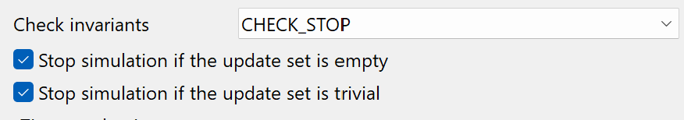
AsmetaS
Before starting the simulation set the preferences:
Window -> Preferences -> Asmeta -> Simulator
Notes:
Update set empty -> no functions have been updated
Update set is trivial -> no function has changed its value

Slide 65
AsmetaS
Axiom checker
to check model invariants
Consistent Updates checking
to check for inconsistent updates
Notes:
When running the simulation the simulator performs two actions:
Aximo checker
Consistent updates checking

Slide 66
AsmetaS
Random
Values to monitored functions are automatically assigned
Interactive
Values to monitored functions are inserted by the user
Notes:
When we run the simulation we can choose betwee two simulation type:
Random and interactive

Slide 67
AsmetaS: random simulation
<State 0 (monitored)>
isPillTaken(drawer1)=true
isPillTaken(drawer2)=false
isPillTaken(drawer3)=true
pillDeadlineHit(drawer1)=false
pillDeadlineHit(drawer2)=false
pillDeadlineHit(drawer3)=true
</State 0 (monitored)>
<State 1 (controlled)>
Drawer={drawer1,drawer2,drawer3}
drawerLed(drawer1)=OFF
drawerLed(drawer2)=OFF
drawerLed(drawer3)=OFF
isPillTobeTaken(drawer1)=false
isPillTobeTaken(drawer2)=false
isPillTobeTaken(drawer3)=true
</State 1 (controlled)>
<State 1 (monitored)>
isPillTaken(drawer1)=false
isPillTaken(drawer2)=false
isPillTaken(drawer3)=false
pillDeadlineHit(drawer1)=false
pillDeadlineHit(drawer2)=true
pillDeadlineHit(drawer3)=true
</State 1 (monitored)>
<State 2 (controlled)> drawerLed(drawer3)=ON
isPillTobeTaken(drawer2)=true
isPillTobeTaken(drawer3)=true
… </State 1 (controlled)>
Notes:
Here we have an example of the output of the AsmetaS tool using random simulation.
In this case, the random simulation selects that pill in drawer 3 hit the deadline (pillDeadlineHit(drawer3)=true),
then in the next state we can notice that the controlled function that pill in drawer 3 has to be taken is set to true.
And next the led of drawer 3 is turned on.
Since in random simulation the simulator automatically choose a value from those possible,
every time you could get a different simulation and there is no possibility to interfer with it.

Slide 68
AsmetaS: random simulation
<State 0 (monitored)>
isPillTaken(drawer1)=true
isPillTaken(drawer2)=false
isPillTaken(drawer3)=true
pillDeadlineHit(drawer1)=false
pillDeadlineHit(drawer2)=false
pillDeadlineHit(drawer3)=true
</State 0 (monitored)>
<UpdateSet - 0>
isPillTobeTaken(drawer3)=true
</UpdateSet>
<State 1 (controlled)>
Drawer={drawer1,drawer2,drawer3}
drawerLed(drawer1)=OFF
drawerLed(drawer2)=OFF
drawerLed(drawer3)=OFF
isPillTobeTaken(drawer1)=false
isPillTobeTaken(drawer2)=false
isPillTobeTaken(drawer3)=true
</State 1 (controlled)>
<State 1 (monitored)>
isPillTaken(drawer1)=false
isPillTaken(drawer2)=false
isPillTaken(drawer3)=false
pillDeadlineHit(drawer1)=false
pillDeadlineHit(drawer2)=true
pillDeadlineHit(drawer3)=true
</State 1 (monitored)>
<UpdateSet - 1>
drawerLed(drawer3)=ON
isPillTobeTaken(drawer2)=true
isPillTobeTaken(drawer3)=true
</UpdateSet>
Notes:
Here we have an example of the output of the AsmetaS tool using random simulation.
In this case, the random simulation selects that pill in drawer 3 hit the deadline (pillDeadlineHit(drawer3)=true),
then in the next state we can notice that the controlled function that pill in drawer 3 has to be taken is set to true.
And in the update set of state 1 the led of drawer 3 is turned on.
Since in random simulation the simulator automatically choose a value from those possible,
every time you could get a different simulation and there is no possibility to interfer with it.

Slide 69
AsmetaS: random simulation
DEMO
Notes:
Let’s now randomly simulate the specification and compare the result with the closest person to you.
In most of the cases you got different results, and this is because each time the simulator randomly choses one of the possible values

Slide 70
AsmetaS: interactive simulation
Simulation scenario: pill in drawer 1 must be taken
the pill in drawer 1 hits the deadline
the pill becomes to be taken
the LED becomes ON
the user takes the pill
the LED becomes OFF
Notes:
To demonstrate the interactive simulation we define the followin scenario

Slide 71
AsmetaS: interactive simulation
Running interactively pillbox_ground.asm
INITIAL STATE:
Drawer={drawer1,drawer2,drawer3}
Insert a boolean constant for pillDeadlineHit(drawer1):true
Insert a boolean constant for pillDeadlineHit(drawer2):false
Insert a boolean constant for pillDeadlineHit(drawer3):false
1
Notes:
The pill in drawer 1 hits the deadline

Slide 72
AsmetaS: interactive simulation
<State 0 (monitored)>
pillDeadlineHit(drawer1)=true
pillDeadlineHit(drawer2)=false
pillDeadlineHit(drawer3)=false
</State 0 (monitored)>
<UpdateSet - 0>
isPillTobeTaken(drawer1)=true
</UpdateSet>
2
Notes:
the pill becomes to be taken

Slide 73
AsmetaS: interactive simulation
<State 1 (controlled)>
drawerLed(drawer1)=OFF
drawerLed(drawer2)=OFF
drawerLed(drawer3)=OFF
isPillTobeTaken(drawer1)=true
isPillTobeTaken(drawer2)=false
isPillTobeTaken(drawer3)=false
</State 1 (controlled)>
Insert a boolean constant for pillDeadlineHit(drawer1):false
Insert a boolean constant for pillDeadlineHit(drawer2):false
Insert a boolean constant for pillDeadlineHit(drawer3):false
2
Notes:
the pill becomes to be taken and no more pills hit the deadline

Slide 74
AsmetaS: interactive simulation
<State 2 (controlled)>
drawerLed(drawer1)=ON
drawerLed(drawer2)=OFF
drawerLed(drawer3)=OFF
isPillTobeTaken(drawer1)=true
isPillTobeTaken(drawer2)=false
isPillTobeTaken(drawer3)=false
</State 2 (controlled)>
Insert a boolean constant for isPillTaken(drawer1):true
3
4
Notes:
the led becomes ON
the user takes the pill

Slide 75
AsmetaS: interactive simulation
<State 2 (controlled)>
drawerLed(drawer1)=OFF
isPillTobeTaken(drawer1)=false
…
5
Notes:
the led becomes OFF

Slide 76
Animation AsmetaA
Notes:
The main disadvantage of the simulator is that it is textual, and this sometimes makes it difficult to follow the computation of the model.
For this reason, ASMETA has a model animator, AsmetaA [11], which provides the user with complete information about all state locations,
and uses colors, tables, and figures over simple text to convey information about states and their evolution.

Slide 77
AsmetaA
Random
Values to monitored functions are automatically assigned
Interactive
Values to monitored functions are inserted by the user

Slide 78
AsmetaA: random animation
The pill in drawer 1 hits the deadline

Slide 79
AsmetaA: random animation
The pill in drawer 2 and drawer 3 hit the deadline
The pill in drawer 1 becomes to be taken

Slide 80
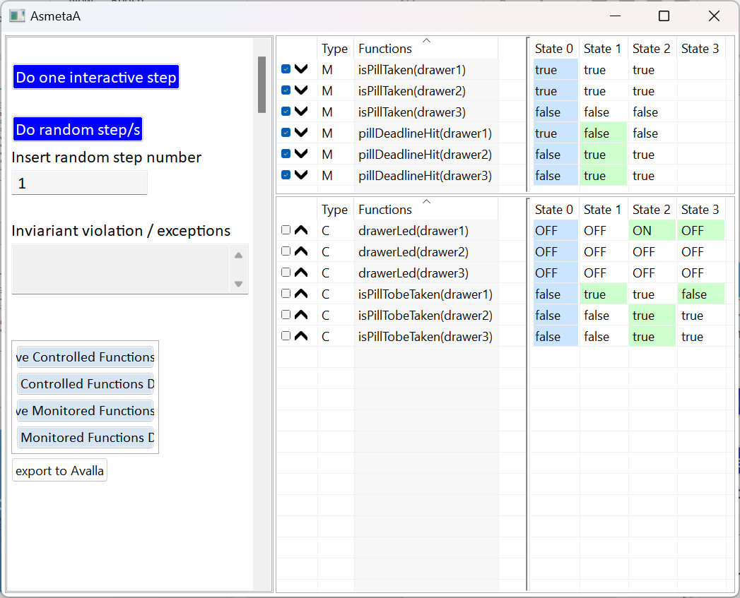
AsmetaA: random animation
The LED in drawer 1 becomes ON
The pills in drawer 2 and drawer 3 become to be taken

Slide 81
AsmetaA: random animation
The LED in drawer 1 becomes OFF

Slide 82
AsmetaA: interactive animation
DEMO

Slide 83
AsmetaA: interactive animation
DEMO
Simulation scenario: two pills must be taken concurrently
the pills in drawer 1 and drawer 2 hit the deadline
the pills become to be taken
the Pill-Box randomly chooses which pill is assumed before and the corresponding LED becomes ON
the user takes the pill
the LED becomes OFF
the LED of the other pill becomes ON
Notes:
the Pill-Box turns ON only a single LED per time, by randomly choosing the order in which to assume them

Slide 84
AsmetaA: interactive animation
DEMO
The pills in drawer 1 and drawer 2 hit the deadline
Notes:
the Pill-Box turns ON only a single LED per time, by randomly choosing the order in which to assume them

Slide 85
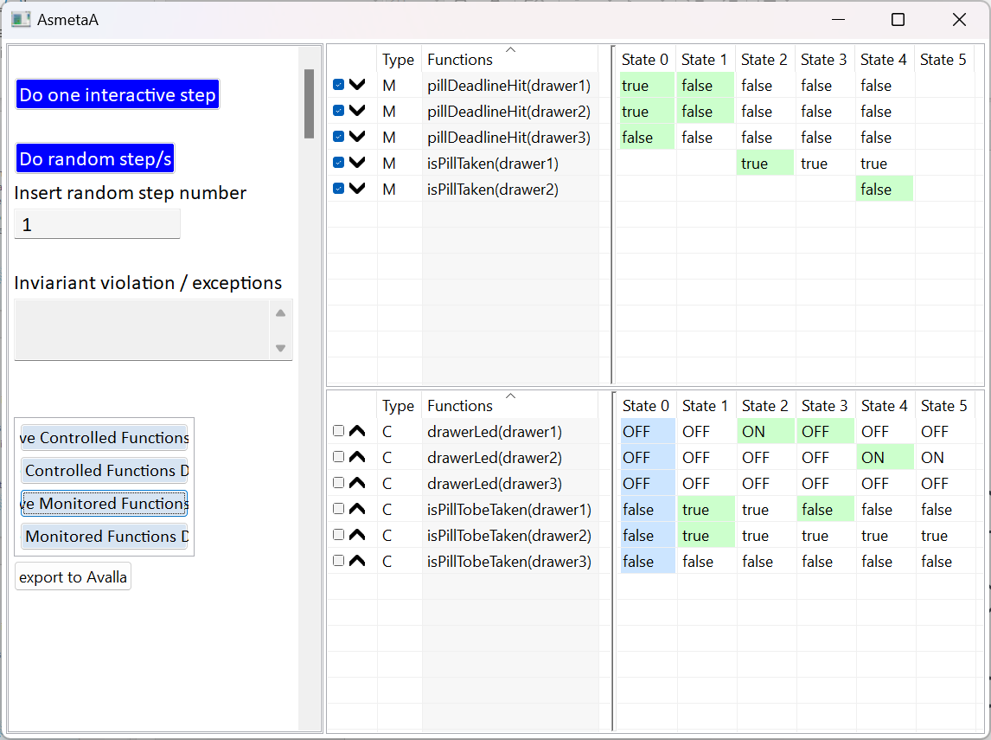
AsmetaA: interactive animation
DEMO
The pills become to be taken
Notes:
the Pill-Box turns ON only a single LED per time, by randomly choosing the order in which to assume them

Slide 86
AsmetaA: interactive animation
DEMO
The Pill-Box randomly chooses which pill is assumed before and the corresponding LED becomes ON
The user takes the pill in drawer 1
Notes:
the Pill-Box turns ON only a single LED per time, by randomly choosing the order in which to assume them

Slide 87
AsmetaA: interactive animation
DEMO
The LED of drawer 1 becomes OFF
Notes:
the Pill-Box turns ON only a single LED per time, by randomly choosing the order in which to assume them

Slide 88
AsmetaA: interactive animation
DEMO
The LED of drawer 2 becomes ON
Notes:
the Pill-Box turns ON only a single LED per time, by randomly choosing the order in which to assume them

Slide 89
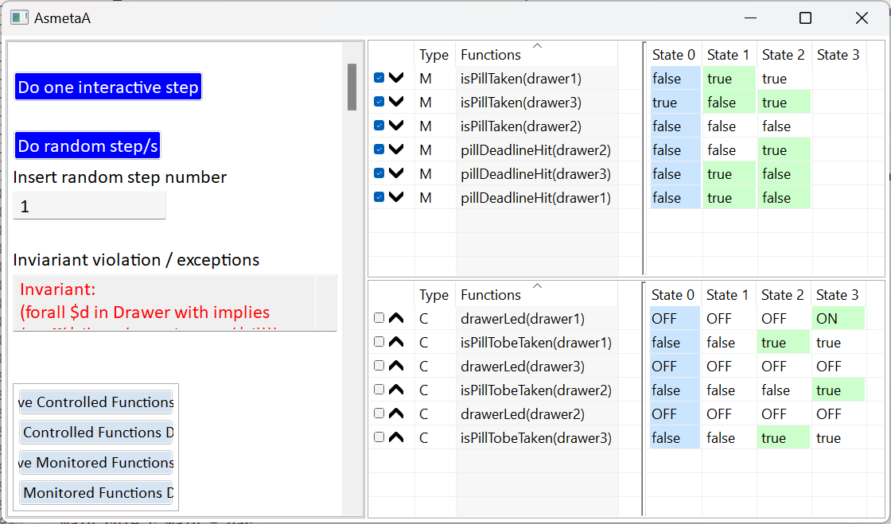
Invariant violation
invariant inv_drawer2 over Drawer: (forall $d in Drawer with (isOff($d)))
Notes:
Let’s add this invariant to the specification: all the led are OFF
This means that when a led becomes on there is an invariant violation and the animation stops.
Let’s try with random/interactive animation

Slide 90
Model validation by scenarios construction: AsmetaV

Slide 91
Scenari
Andrea
Sezione 7
Tempo: 15 minuti

Slide 92
Scenario-based Validation
Scenarios are
Descriptions of external actor actions and reactions of the system
Useful to check the correct behavior of the model
Written in the Avalla language

Slide 93
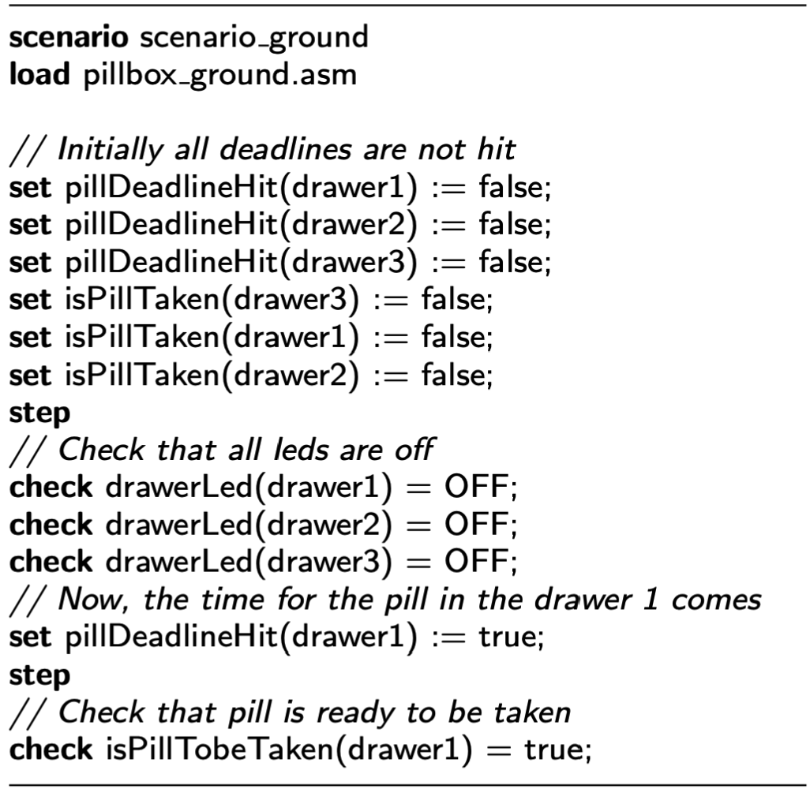
Detailed look of an Avalla scenario
Scenario name
Keyword scenario followed by the name

Slide 94
Detailed look of an Avalla scenario
Loading Asmeta specification
Keyword load followed by the name (or the path) of a specification
Each scenario is executed against an Asmeta specification

Slide 95
Detailed look of an Avalla scenario
Setting monitored functions
Keyword set followed by
the name of the monitored location (read by the machine from the environment)
the value to be assigned

Slide 96
Detailed look of an Avalla scenario
Step execution
step command
… or …
stepUntil command, followed by a Boolean condition

Slide 97
Detailed look of an Avalla scenario
Checking controlled functions
Keyword check followed by
the name of the controlled location
the value to be checked
The check can either PASS or FAIL

Slide 98
AsmetaV
After having written a scenario, it can be executed through:
The simple AsmetaV validator
The execution of a scenario through animation
The AsmetaV validator keeping track of covered rules

Slide 99
Model Review
Andrea
Sezione 8
Tempo: 10 minuti

Slide 100
Static analysis of models AsmetaMA

Slide 101
Model Review
The automatic model reviewing activity:
Is a form of static analysis
Automatically captures modeling errors (e.g., inconsistent updates, dead specification parts, …) through 7 meta properties checked by exploiting the model checker

Slide 102
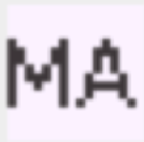
AsmetaMA
Given an ASMETA specification, it can be triggered by using the command

Slide 103
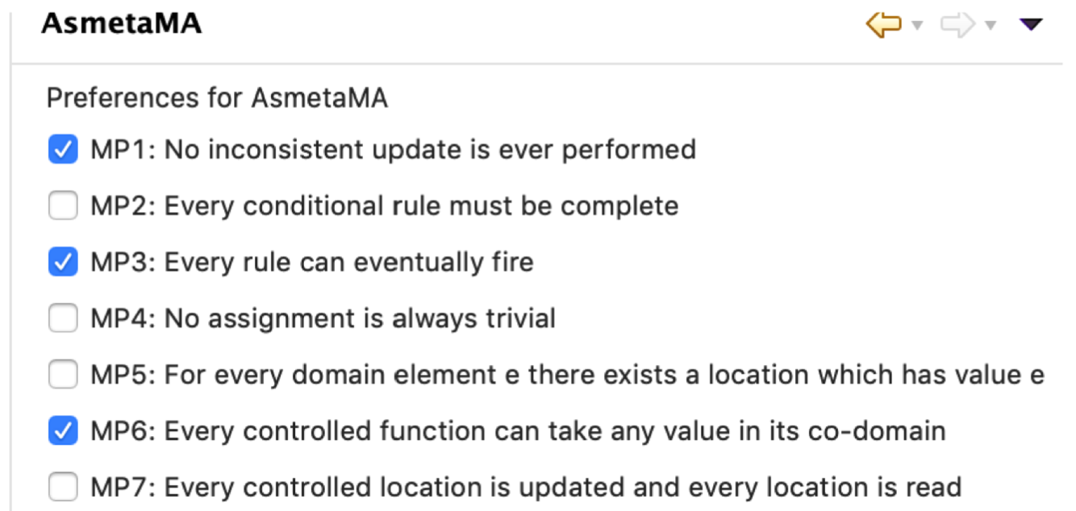
AsmetaMA
Before starting the model reviewer, set the preferences:

Slide 104
Verifica
Angelo
Supponiamo che sanno la logica temporale
Sezione 9
Tempo: 20 minuti

Slide 105
Property Verification AsmetaSMV

Slide 106
Model checking

Slide 107
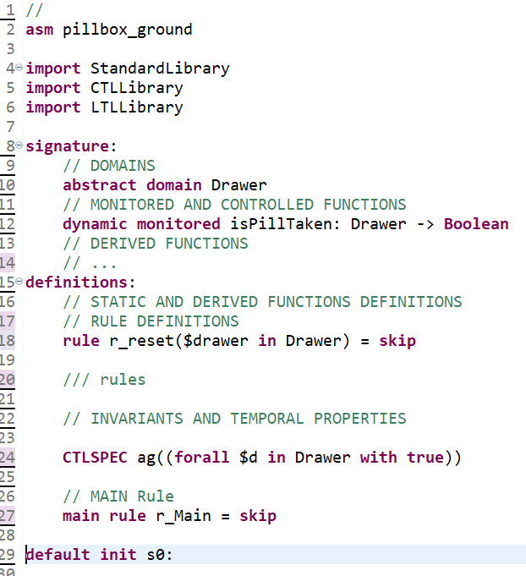
In ASMETA:
Domains, functions and rules
Machine M
(Kripke structure)
TL properties
Properties to be proven
Notes:
Definition of M already seen, let’s see the definition of temporal properties.

Slide 108
Temporal logics
discrete time logics
Linear Time Logics (LTL) represent time as infinite sequences of instant
you can declare properties that must be true over all sequences
Computational Time Logics (CTL) represent time as a tree, where the root is the initial instant and its children the possible evolutions of the system
you can declare properties concerning all the paths or just some of them

Slide 109
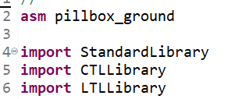
Temporal logics in Asmeta
Import the libraries
Write the properties
Use keyword
Name (optional)
Boolean term with temporal operators (defined in the libraries)
CTLSPEC or LTLSPEC

Slide 110
Temporal operators in Asmeta
module CTLLibrary
import StandardLibrary
export *
signature:
/*-----------CTL formulas------------*/
static eg: Boolean -> Boolean //exists globally
static ex: Boolean -> Boolean //exists next state
static ef: Boolean -> Boolean //exists finally
static ag: Boolean -> Boolean //forall globally
static ax: Boolean -> Boolean //forall next state
static af: Boolean -> Boolean //forall finally
static eu: Prod(Boolean, Boolean) -> Boolean //exists until
static au: Prod(Boolean, Boolean) -> Boolean //forall until static ew: Prod(Boolean, Boolean) -> Boolean //exists weak until -- E[p U q] | EGp.
static aw: Prod(Boolean, Boolean) -> Boolean //forall weak until -- !E[!q U !(p | q)].
//http://patterns.projects.cis.ksu.edu/documentation/patterns/ctl.shtml
//Absence (P is false)
//Globally - AG(!P)
static absenceG: Boolean -> Boolean
//(*) Before R - A[(!P | AG(!R)) W R]
static absenceBefore: Prod(Boolean, Boolean) -> Boolean // absenceBefore(P, R)
…
CTLLibrary
Similarly the LTLLibrary

Slide 111
Properties for the PillBox
DEMO
If the patient takes the pill in drawer1, the light will turn on eventually
CTLSPEC ag(pillDeadlineHit(drawer1) implies ef(isOn(drawer1)))
Max one led is on
CTLSPEC ag((forall $d in Drawer with isOn($d) implies (not areOthersOn($d))))
Notes:
Scrittura di alcune proprietà sulla specifica ground del pillbox

Slide 112
Proving properties with NuSMV
It is a symbolic model checker derived from CMU SMV
Permits to verify properties written both in Computation Tree Logic (CTL) and in Linear Temporal Logic (LTL)
The internal representation of the model uses the Binary DecisionDiagrams (BDDs)
States are determined by the variable values
Transitions between states are determined by the updates of the variables

Slide 113
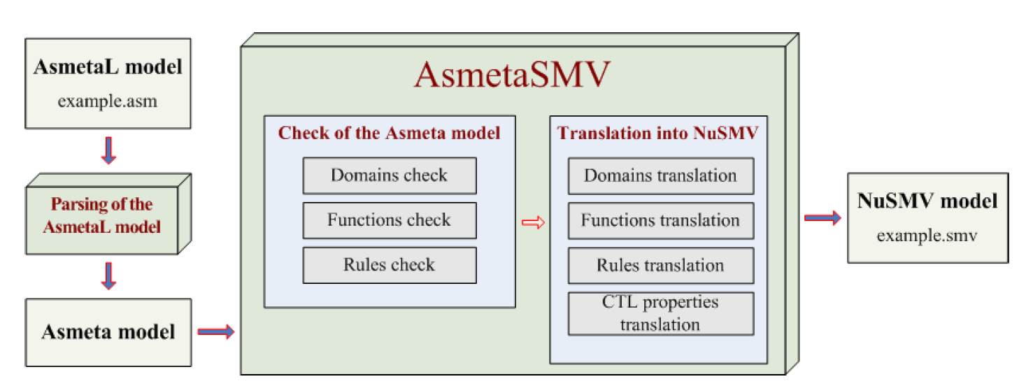
Asmeta models are mapped to NuSMV files (.smv)

Slide 114
Mapping limits
AsmetaSMV cannot translate all the AsmetaL element into NuSMV
an AsmetaL element is not supported because:
it requires conditions that cannot be satisfied in NuSMV
For example, type domains Real, Integer, Char, don't have a corresponding type in NuSMV and so they cannot be used as domains or codomains of functions in AmsetaL models that must be translated
the translation would be too complicated
the case of many turbo rules

Slide 115
Executing AsmetaSMV
T: translates asmeta to NuSMV
Example for pillbox
TE: executes also the model checker
NuSMV executable must be in the path or set in the preferences

Slide 116
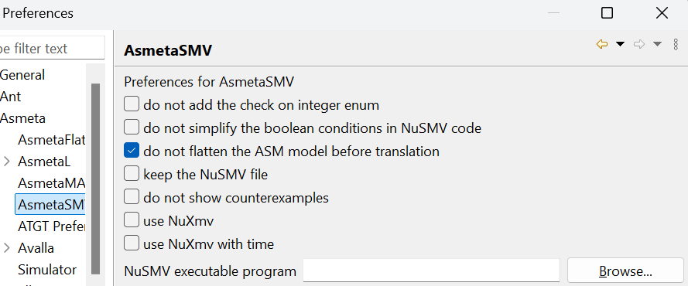
AsmetaSMV preferences

Slide 117
Executing NuSMV
The output of the model checker is pretty printed in terms of elements of the ASMETA signature.

Slide 118
Counter example
-- specification AG (pillDeadlineHit(DRAWER1) -> AF drawerLed(DRAWER1) = ON) is false
-- as demonstrated by the following execution sequence
Trace Description: CTL Counterexample
Trace Type: Counterexample
-> State: 1.1 <-
pillDeadlineHit(DRAWER1) = false
drawerLed(DRAWER1) = OFF
var_$drawer_0 = DRAWER1
drawerLed(DRAWER2) = OFF
isPillTobeTaken(DRAWER2) = false
drawerLed(DRAWER3) = OFF
isPillTobeTaken(DRAWER3) = false
isPillTobeTaken(DRAWER1) = false
isPillTaken(DRAWER1) = false
isPillTaken(DRAWER2) = false
pillDeadlineHit(DRAWER2) = false
isPillTaken(DRAWER3) = false
pillDeadlineHit(DRAWER3) = false
areOthersOn(DRAWER3) = false
areOthersOn(DRAWER2) = false
areOthersOn(DRAWER1) = false
-> State: 1.2 <-
pillDeadlineHit(DRAWER1) = true
pillDeadlineHit(DRAWER2) = true
-- Loop starts here
-> State: 1.3 <-
…
If a property is false, a counter example is shown
CTLSPEC ag(pillDeadlineHit(drawer1) implies af(isOn(drawer1)))

Slide 119
Liveness property
Liveness: “Something good will eventually happen”.
For instance: “Whenever any process requests to enter its critical section, it will eventually be permitted to do so”.
In CTL AG + AF or AG + EF
AG(request → AF(critical))

Slide 120
Deadlock absence
In CTL AG EX true
whatever the status reached (AG), there is a status immediately successor (EX true)
No deadlock

Slide 121
Some notes
AsmetaSMV is used by ATGT for generating abstract tests (avalla scenario)
nuXmv which supports infinite domains is partially supported as well
we are working on using SMT for proving (not only for refinement checking)

Slide 122
Raffinamento
Silvia
Come il ground visto prima è stato modificato
Sezione 10
Tempo: 15 minuti

Slide 123
Model Refinement
Notes:
As said before, we have developed three models by appling refinement.
In these slides we are going to show how we have improved the models

Slide 124
Pill-Box case study: first refinement step
First model Pillbox ground | Second model Pillbox time
A drawer contains only a single pill (no slots) Time not modeled: information on the time passed is given by an external event | A drawer contains only a single pill (no slots) Time is modeled using a timer
Notes:
The first model refinement we propose consists in explicitly modeling time passing,
to capture the requirement stating that the LED stays on for 10 minutes after the scheduled time to take the pill.

Slide 125
Pillbox time
Time library features:
Check if timer is expired
Reset a timer
Notes:
Dealing with timers requires importing the predefined time library and setting a suitable timer as an element of the abstract domain Timer.
Then the duration of the timer tenMinutes is set to 600 time unit (seconds, in this case) and its starting time is equal to the current time
The current time is taken from the library, which in turn is taken as monitored value from the Java virtual machine
The time library provides also two functions: expired to check if a timer is expired, and reset to reset the timer

Slide 126
Pillbox time
Pillbox ground
Pillbox time
………..
Notes:
The monitored function pillDeadlineHit has been refined by the controlled function time_consumption
For each drawer we have specified the time to take the pill
And by means of the derived function pillDeadlineHit, it is possible to check if a pill has hit a deadline.

Slide 127
Pillbox time
Pillbox ground
Pillbox time
Notes:
The behavior of the rule r choosePillToTake is refined by adding the new rule r pillToBeTaken
The nuew rule, when a pill should be taken, turns on the led and (if the led is off) reset the timer tenMinutes to start the 10-minute count in which the led must be ON till the pill is taken

Slide 128
Pill-Box case study: second refinement step
Second model Pillbox time | Third model Pillbox final
A drawer contains only a single pill (no slots) Time is modeled using a timer | A drawer contains multiple slots
Notes:
Then we have a second refinement step.
The final model captures all requirements of the Pill-Box system.
Each drawer contains multiple slots/pills

Slide 129
Pillbox final
Pillbox time
Pillbox final
Notes:
The function time_consumption has been refined
It maps each drawer into a sequence of integers, containing the time
deadlines expressed in seconds.
Then the function drugIndex associates with each drawer an integer
indicating the next slot to be emptied in the corresponding drawer. The two
functions are initialized accordingly:
We assume that the deadline are in ascending order

Slide 130
Pillbox final
Pillbox time
Pillbox final
Notes:
The derived function pillDeadlineHit is refined to check the pill’s deadline in the drawer’s current slot to be emptied.
The newly derived function isThereAnyOtherDeadline indicates if there is any other pill in the drawer to be taken.

Slide 131
Pillbox final
Pillbox time
Pillbox final
Notes:
The derived function isThereAnyOtherDeadline is used to refine the rule r setOtherDrawers
which leads to suitably updating the drawer state (led status and drug index) by invoking the
(nested and refined) macro call rule r reset.

Slide 132
Generazione codice
Angelo
Sezione 11
Tempo: 10 min

Slide 133
Code generation
Notes:
As we showed during the case study presentation, we have developed three models by appling refinement.
Refinement is a techinique to develop an improved model with more details compared to the previous one.

Slide 134
Code generation from Asmeta spec
Requirement capture by modeling and refinement
model-driven engineering:
Code are generated
the last refinement can be translated to code
C++
C++ for Arduino
Java
Asmeta2C++ tool
ASM 0
Refinement
ASMRefProver
ASM 1
ASM i
Implementation
ASM n
CODE generation
???
Code

Slide 135
AsmetaC++
Asmeta
.h: interface with the translation of model domain declarations and definitions, function and rule declarations.
.cpp: rules implementation,
the functions and domain initialization, and the definitions of the functions.

Slide 136
Asm to C++
Translates an ASM to a C++ class (platform independent)
Only available as command line tool
https://github.com/asmeta/asmeta/tree/master/code/experimental/asmetal2cpp/asmetal2cpp_cli/dist
Demo…
MyMachine.asm
MyMachine.h
MyMachine.cpp
C++ class (header) with
definition:
Signature with types and fields
declaration:
Rules as class methods
Predefined declared methods
getInputs()
r_Main()
fireUpdateSet()
setOuputs()
C++ class implementation with the behavior (rules + ASM step semantics)
Rules as class methods
r_Main() for the main rule
fireUpdateSet() for step semantics

Slide 137
Asm to C++ : example
LedSystem.h
asm LedSystem
enum LedState = {LOW, HIGH}
monitored dimValue -> Integer
controlled led -> LedState
rule r_setLedLow = led := LOW
rule r_setLedHigh = led := HIGH
rule r_Main =
if dimValue > 400 then r_setLedHigh[]
else r_setLedLow[]
endif
class LedSystem{
// DOMAIN DEFINITIONS
enum LedState {LOW, HIGH};
// FUNCTIONS
int dimValue;
LedState led[2];
public:
// RULE DEFINITION
void r_setLedLow();
void r_setLedHigh();
void r_Main();
void getInputs();
void setOutputs();
void fireUpdateSet();
};
.h
.cpp
LedSystem.cpp
void LedSystem:: r_setLedLow(){
led[1] = LOW
}
void LedSystem::r_Main(){
if (dimValue > 400){
r_setLedHigh();
} else{ .. }
}

Slide 138
Some notes
Also avalla scenarios can be translated to unit tests (both in C++ and Java)
If using Arduino, the framework generates also extra code for hardware integration

Slide 139
Conclusions

Slide 140
Conclusions
The artifacts for the tutorial paper are available at https://doi.org/10.5281/zenodo.12770854
Soon also on the github pages
Suggestions and issues are welcome, submitted to github
If you could leave your email we will ask for a feedback

